Slide 1

Predicting Bank Customer Loan Default using Machine Learning
Presented by-
1.Ronit Raj
2.Anshu Prasad

Slide 2
Problem Statement:
A bank wants to build a machine learning model that can predict whether a customer will default on a loan based on their financial, demographic, and transaction details.

Slide 3

From code in PDF: Data Preparation
df = pd.read_csv("/content/Loan_default.csv")
content
Dataset properties:
Target variable: Default
Independent variables include:
Income, LoanAmount, Balance
NumCreditLines, MonthsEmployed
Categorical: Gender, Occupation, LoanType

Slide 4
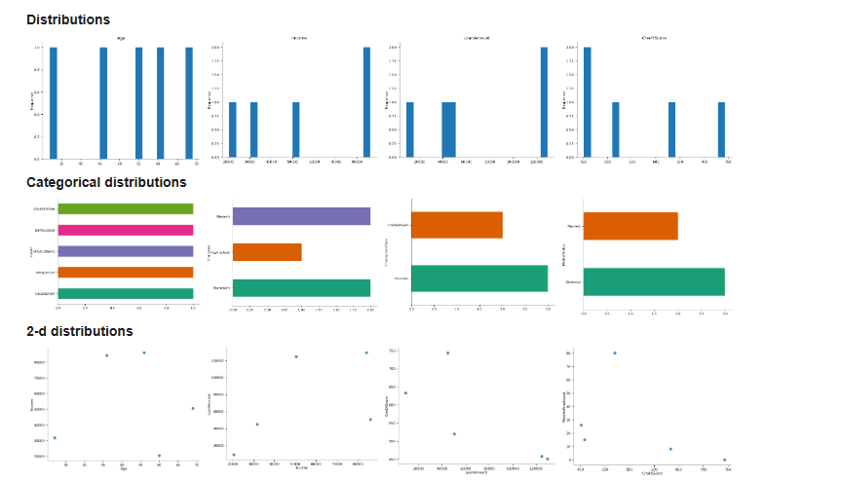

Slide 5
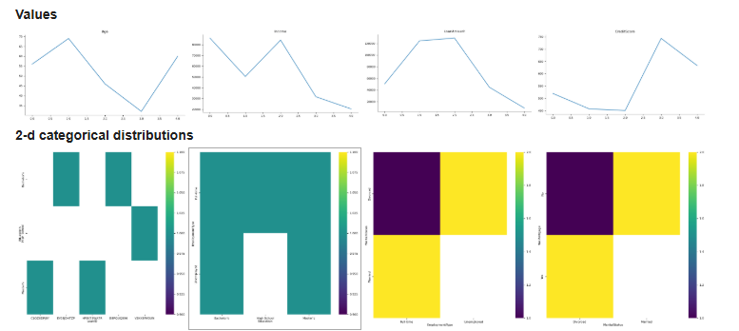

Slide 6

Implemented using ColumnTransformer + Pipeline:
content
Numeric preprocessing
Median imputation
StandardScaler normalization
Categorical preprocessing
Most frequent imputation
OneHotEncoding (handle_unknown="ignore")
Ensures zero leakage & consistent preprocessing inside each model.

Slide 7

Missing values
Handled via:
SimpleImputer(strategy="median") for numeric
SimpleImputer(strategy="most_frequent") for categorical
Outliers
Scaling via StandardScaler reduces amplitude of extreme values.
Dataset imbalance
Used Stratified Train-Test Split: stratify=y → preserves ratio of default vs non-default.

Slide 8
Feature Engineering
Income_to_Loan Ratio Income / (LoanAmount + 1) Helps model understand ability to repay.
CreditLines_per_Year NumCreditLines / (MonthsEmployed/12 + 1) Measures credit frequency relative to employment time.
These increase model signal strength.

Slide 9

Methods used:
Correlation analysis
Model-based ranking:
Logistic Regression coefficients
RandomForest feature importance
XGBoost gain scores

Slide 10

Performed as: train_test_split(test_size=0.2, random_state=42, stratify=y)
content
80% train
20% test
Stratification ensures balanced evaluation.

Slide 11

Model Building
Three ML models were trained:
1. Logistic Regression
Baseline linear classifier
max_iter=200
2. Random Forest
100 trees, max_depth=10
3. XGBoost
n_estimators=80
learning_rate=0.1
subsample=0.8

Slide 12
Every model is wrapped inside:
Pipeline([
("preprocessor", preprocessor),
("model", ML_algorithm)
])
Benefits:
No leakage
Same preprocessing for all models
Easy reproducibility
Cleaner training flow

Slide 13

Each model trained using:
clf.fit(X_train, y_train)
Predictions computed:
y_pred = clf.predict(X_test)
y_prob = clf.predict_proba(X_test)[:,1] (used for ROC-AUC)
Evaluation is consistent across models.

Slide 14
Model Testing & Evaluation
Performance Metrics Used
Accuracy
Precision
Recall
F1-Score
ROC-AUC — most important for imbalance
Confusion Matrix

Slide 15
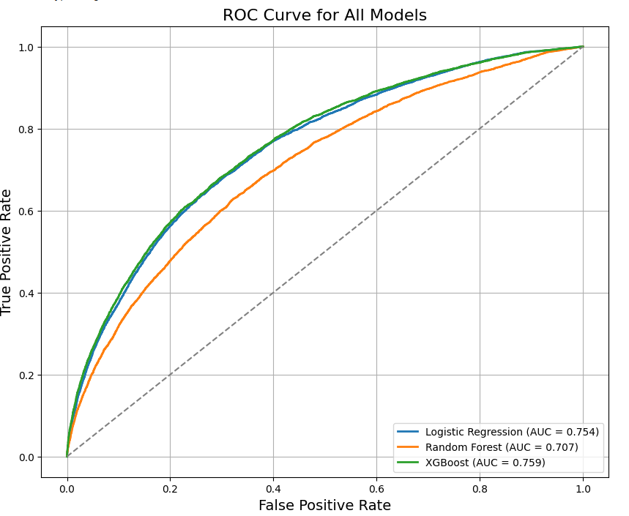

Slide 16
AUC Scores:
Logistic Regression → 0.754
Random Forest → 0.707
XGBoost → 0.759 (best)
XGBoost slightly outperformed Logistic Regression.

Slide 17

Model predicted:
Majority class extremely well
Minority class (Default=1) recall is very low (0.03)
Conclusion: LR struggles with minority class detection due to imbalance.

Slide 18
Random Forest predicted zero class-1 defaults.
Precision for default=0 → 0.88
Recall for default=1 → 0.00

Slide 19
XGBoost:
Better recall for default (0.06)
Best F1 among models (0.11 for class-1)
Best AUC (0.759)

Slide 20
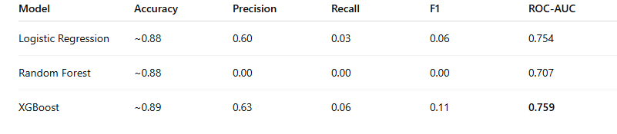

Slide 21
Models are highly accurate because the dataset is dominated by non-default customers
But true business value lies in catching defaulters
XGBoost gives:
Highest AUC
Best minority recall
Better balance between FP vs FN
Hence, XGBoost is the best starting point.

Slide 22
Recommended Model: XGBoost Classifier
Reasons:
Best ROC-AUC = 0.759
Best separation of classes
Slightly improved detection of defaulters
More robust to nonlinear patterns

Slide 23
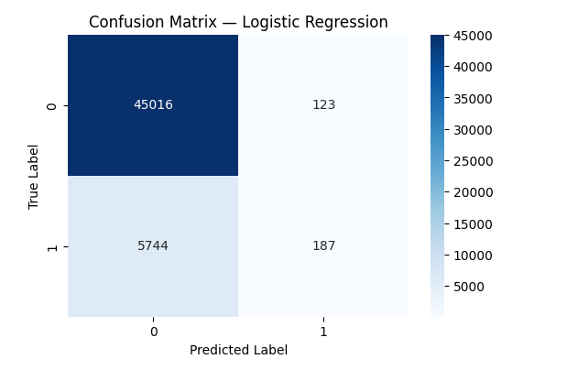

Slide 24
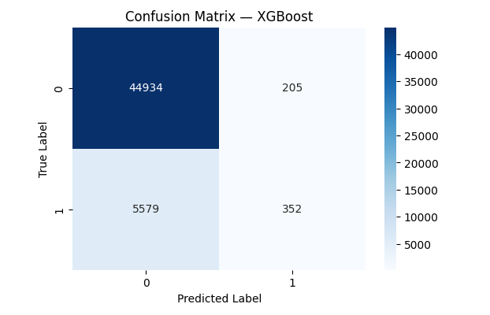

Slide 25
This project successfully demonstrated:
End-to-end ML pipeline
Handling of missing values, categorical encoding, scaling
Feature engineering
Evaluation with ROC, AUC, confusion matrices
Comparison of 3 major ML models
Model recommendation for deployment

